Slide 1
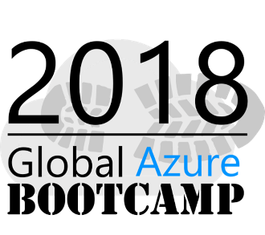
Azure Application Insights and Jupyter Notebook to analyze large scale data
Notes:
Not just any monitoring, but proactive monitoring!
helps you and your team identify issues before your users have a chance to tweet, email or Instagram that issue that affects their smooth user experience
Developers are delighted, Operations teams are happy and managers can finally focus on creating awesome teams and products instead of firefighting issue after issue.
Visual Studio (Code) tooling,
intelligent monitoring,
advance analytics,
dependency maps and devops integration are some of the awesome features that AppInsights have to offer . Don't believe me? Great! Join me in this session and let me prove you wrong!
apparently all of you here like the topic appinsights welcome all

Slide 2
Who am I?
Senior Tech Lead at 99X Technology
MVP – Visual Studio and related technologies
Top Contributor on Stack Overflow https://stackoverflow.com/users/1749403/sajeetharan
Opensource Contributor
https://github.com/sajeetharan
Angular Enthusiast
https://stackblitz.com/@sajeetharan

Slide 3
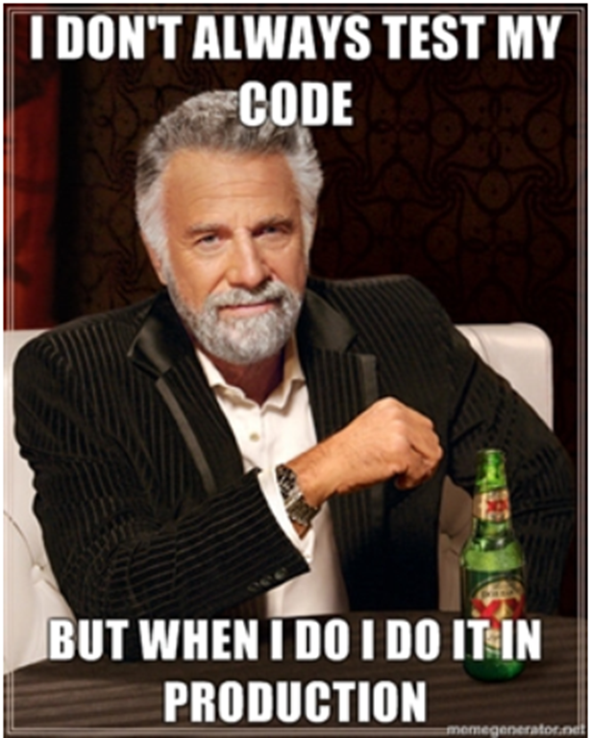

Here is a small story….
Notes:
How many of you are developers here and how many of you agree with the first image? Those who agreed should be really lucky to work in the same company, because 2nd image shows the reality.
Story -> “The application crashed every time I am drinking coke. And when ever it happens, I have restart the browser and enter all the details from the beginning. Please look into the issue and resolve is ASAP”
Two weeks gone and the customer gets angry , QA team also tried to do the same.
Time out procedure in application and it was never tested before and there was a bug.

Slide 4
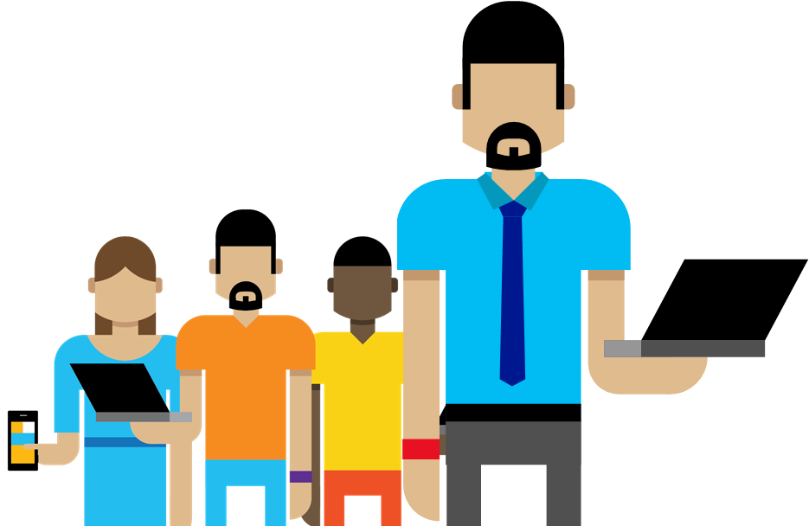
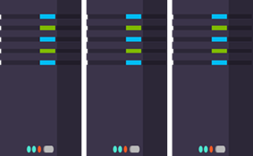
Why Logging?
1
Troubleshooting
Did a problem occur? Where? When?
2
Performance/Cost
Is the Application slow? How many requests?
3
Analyze Trends
Need more storage? Need more servers?
4
Customer Experience
Is your system making everyone happy?
5
Business Decisions
Increase in sales?
Notes:
One who manage 24/7 operations, every applications are different at different situations that is why this topic is important.
logs to a file somewhere on the file and distributed to customers who never looked at it again and some of them dint have idea on what to look at when they have problems. all these takes time to identify the problem
today we have very different situation each system has become messaging bunch of things, any one in this room build application with just two components ? there are lot of moving pars
there are lot of components in it, authentication,authorization,identity management so that becomes a service in the cloud some sort of azure ad, auth0 OR SAS providers. storage (blobs,cdns). eventhubs queues
to sort of distribute our architecture. we got telemetry of data coming from all over the place.
hello world is not what it used to be , there a lot of things flying around all over the place one of the
obvious thing to manage is to log all the things. discover upfront.
when site is down everyone is stressed, you need an answer now after an hour or 4 hours later, you need
to find out now.
want to get alerts scale out automatically.
logging:
most log files really suck. typically why would you log stuffs in application
troubleshooting- did a problem occur? where? our code? machine
performance/cost = did we make application slower - how many requests are coming, may be need of addition machines
improvement- can a problem be detected or avoided - exception is occurring, what is the causing
trends - need more storage? need more servers? - disk runs out of space, how can i fix this
customer experience - are people happy? or seeing error after error? 5 seconds to load application
business decisions - can we increase sales based on log data/telemetry - page views number of orders go to your transacation.

Slide 5
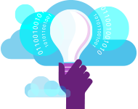
What is Application Insights?
“Application Insights is an extensible Application Performance
Management (APM) service for web developers on multiple
Platforms”.
1
3
Telemetry is collected at each tier: Mobile applications, server applications and browser
Get a 360° view of the application including availability, performance and usage patterns
2
Telemetry arrives in the Application Insights service in the cloud, where it is processed & stored
Notes:
the number one thing that comes up after you launch is what's going in the database, hats going on live cloud
something is not communication server is down and i am getting errors and it happens all the times.
i see 80 pages document on a regular basis from my customer asking us to answer to questionnaire given
by somebody to whom they want to sell their services to.
security audits, review and early detection

Slide 6
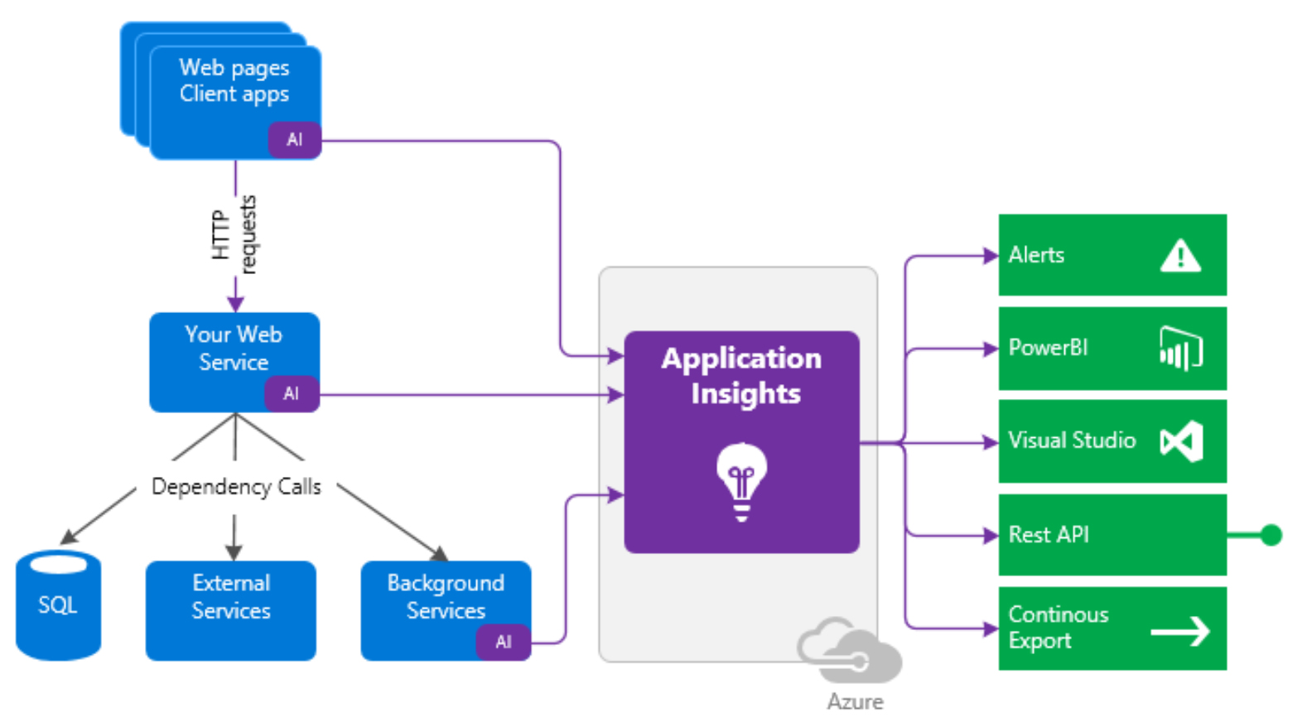
How it works
Notes:
you all look serious but this is something fun to implement.
tracking change history
wat sort of changes have been done in the system.
insights to user activity
what to log
event logs - no1 thing we start with when we build application. diagnostic trace into blob storage in azure, default logging experience for every application and cloud platform.
audit logs -
activity logs - common increasing demand for this , user feature usage.
history logs - show to user or customer to track a problem.
things going in the system.
Implement a interface typed implementation so that we can extend method set of methods that are easy
for anybody to write code to (tracing at various levels)
something super simple.
will be giving one pattern, someone may like using DI, dynamic loading of different logger and have
that reelect based, its just the concept.
i think ive made my point.
best approach is just get it done.
single line logger

Slide 7
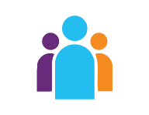



Sources of Telemetry
1
Outside-in monitoring
URL pings and web tests from 16 global points of presence
2
Observed user behavior
How is the application being used?
3
Developer traces and events
app
Whatever the developer would like to send to Application Insights
4
Observed application behavior
platform
No coding required – service dependencies, queries, response time, exceptions, logs, etc.
infrastructure
Infrastructure performance
5
System performance counters

Slide 8

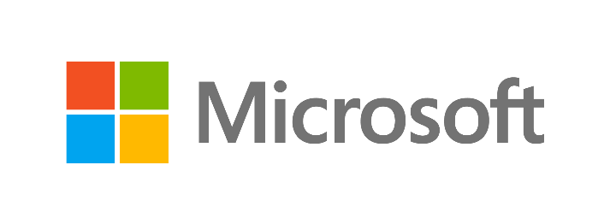



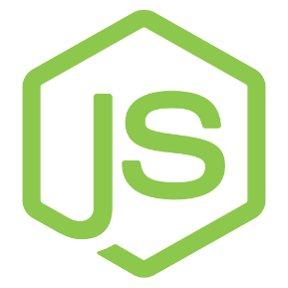



Key capabilities
Any app support
Easily add analytics across multiple platforms including: ASP.NET, Java/J2EE, iOS, Android, Windows, as well as OSS technologies such as Node.JS, PHP, Ruby, Python, etc.
Open source SDK: https://github.com/Microsoft/ApplicationInsights-Home
Logging framework: Log4Net, nLog, System.Diagnostics Log4J, Logback
Notes:
sort of simple name for a service and sdk that gives lot of information and benefits if you start using it
slicing and dicing information there , of course information has to be provided to app insights that's where
sdk comes in.
out of the box, also enriches your data. for exa, if you want to correlate specific trace message with your
cpu machine, the information is already on appinsights, you have eto just query it
it has telemetry - allows you not only to ship login information but also custom events, so that
we can correlate event with business information( combine information for analysis)

Slide 9
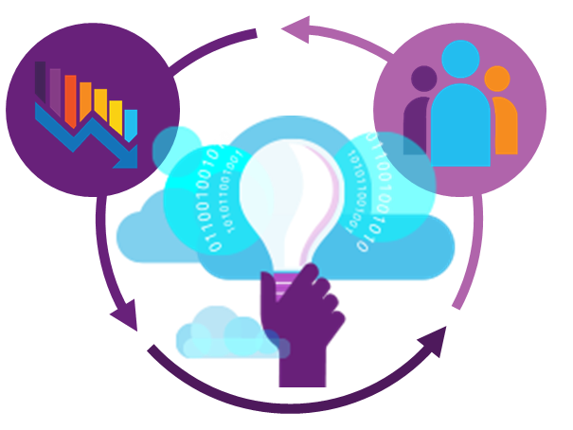
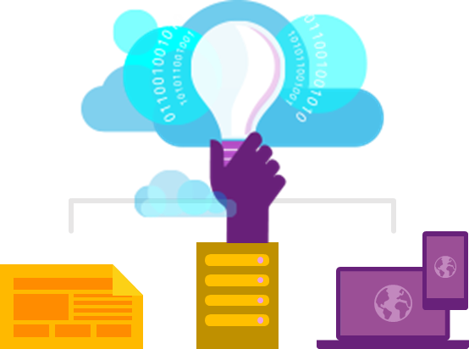
Key capabilities
360° View Across
Availability, Performance & Usage
Overall app health via Overview Blade
Quickly correlate performance & usage data
Detailed insights with a click of a button through intuitive data exploration
Fast & Powerful Diagnostics & Usage Insights
Quickly diagnose availability & performance issues
Learn & improve continuously with usage insights
Extend your telemetry data
Export your data for further analysis
Built-in Analytics
for any app
Supports any app type
Zero-click enablement
No-touch monitoring
Notes:
typically see in lot off applications
log4net
system.diagonistics
or we just write to logfile
something happened in the application we log the exception with the error message not the stack trace,
machine, not the session of the user probably too basic of log information
that does not help much in understanding or troubleshooting the problem.
error : null reference error occurred, value cannot be null
thats the cause of the exception. why the value is null where did it come from? i have no idea.
typical log that you could find in lot of projects, everyone in this room have seen log files log this.
this is not the information you want to habe basically to troubleshoot .
typical log file really sucks for example if user has loggedin with username password or using
external providers such as ad, all the context missing in typical log file.
one consistent view on top of all log files
report and analyse. process the data that you get off from machines make them searchable and
use them.solutions like elastic search view on top (combusom to stepup and you need to
spin up machines in order to process which is time consuming)
correlate everything and read the content and figure out why something happening.
serilog or semantic logging. message link to specific context.
eventsource something inside the dotnet framework really good way of structured logging.
its not really difficult to write these log statements, create a custom class with information needed
and you can console those values with appinsights.
serilog very similar to log4net, structured logging is embeded. serilog will also log string messages and
context. example which customer you are creating
links you can link to write to database,appinsights etc with nuget package serilog
serilog.sinks
- to xml,to database,postgress and appinsights you can install one of this.
search entries that would match the speficic customer.
additional information such as machineid trhead etc.
be careful of what you log such s claims,
correlate things
the cloud to the rescure
- logging and correlating things
- loganalytics

Slide 10
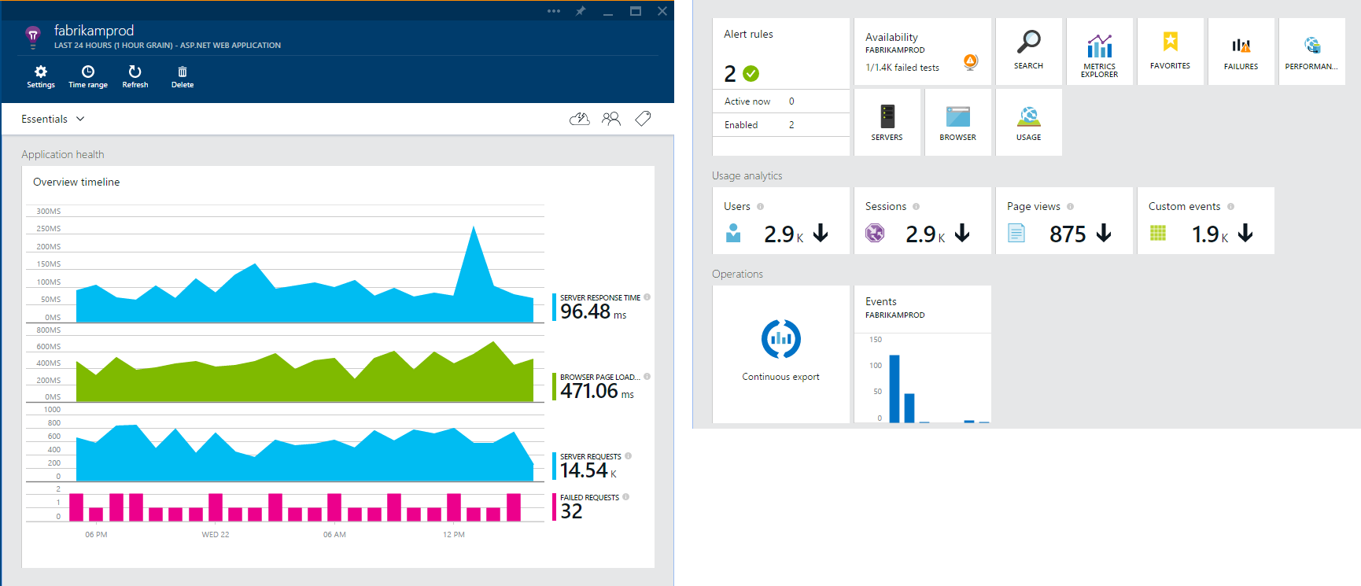
Overview Blade
Out-of-the-box experience
Provides a summary of the application’s health - availability, performance and usage
Paired timeline allows users to quickly correlate metrics and identify trends

Slide 11
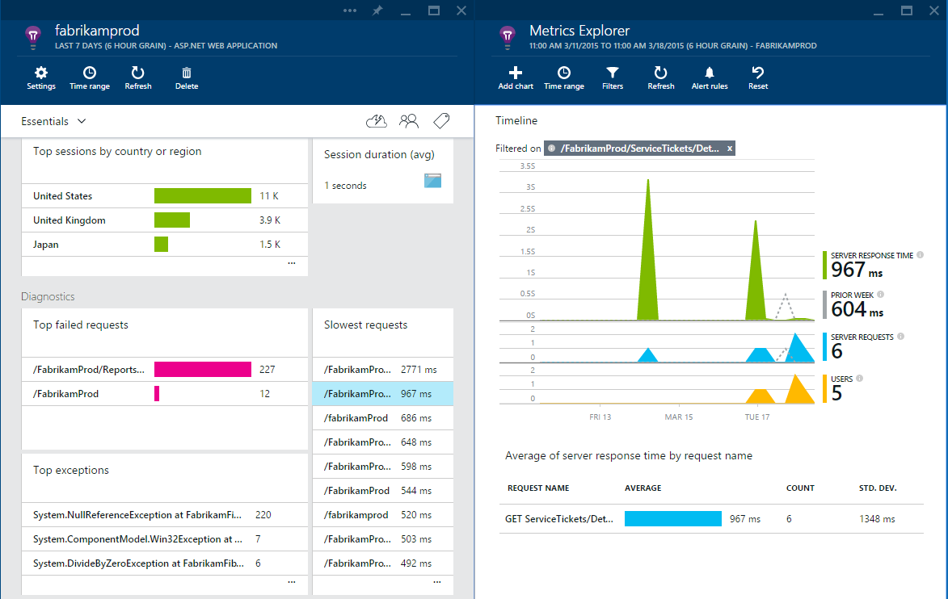
Drill down
Detailed insights with the click of a button
Correlate performance and usage in a single view
Pinpoint problems and investigate questions like “Do I have network performance issues that hurt user adoption?”
Click on specific metrics, and drill into detailed information and answer questions such as “what request is failing the most?”

Slide 12
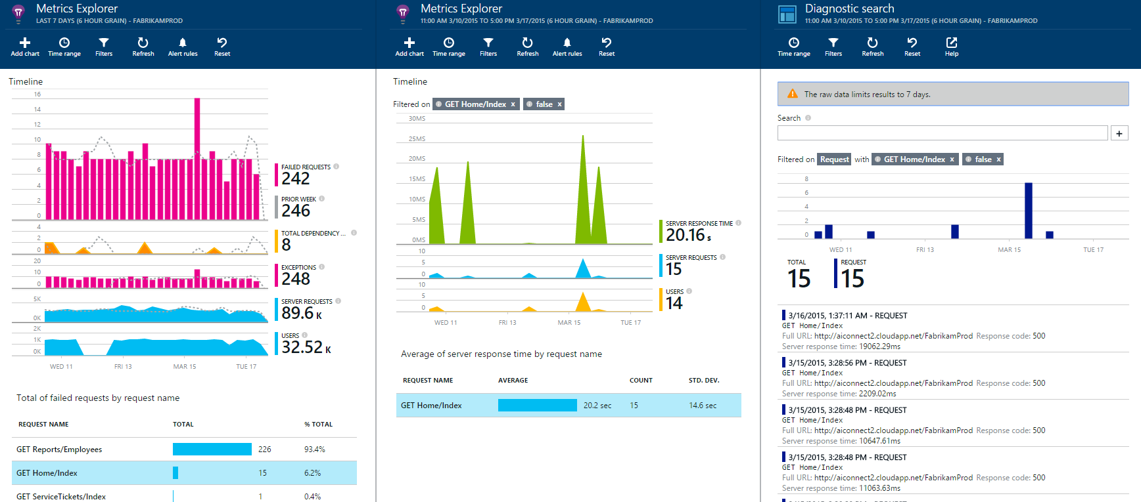
Drill down tools
Powerful insights with Metrics Explorer and Diagnostic Search
Metrics Explorer provides a flexible multi-dimensional UI over custom and out-of-the-box telemetry collected
Diagnostic Search enables efficient search over large sets of data using the query experience
Notes:
capturing dependencies is a cool feature. try to identify the dependencies if you are using sql server
look at get started
some infortion popping up
for web application by default= see the individual request, see whatever happens and time and click further drill down to client address. did i make a call to database. there are lot of information
you basically get for free by adding using sdk to your application, really its useful when you consider.
performance rackers
in nutshell thats what you can see in a portal.
data collected
no of request, exceptions, garbage
requests both on client side and server(correlate both client and server)
traces using serilog (structured logging , performance counter with specific customer)
logging depenedencies with custom details
different view
failed request- drill down to spefici exception and which line of code. which is really useful
usage - who is using my application from different locations session by country ( this is not like google analytc)
performance - which page is fast in terms of load
servers-
browsers - how long does it take to render my SPA etc
really production application( load test on applicaiton)
setup serilog and addserilog
- serilog with structured logging we can correlate the customerid
application insights analytics
sor of addon or separate based on internal tool used at microsoft, pretty much same as sql queries on top
of your logging information, also you can run queries on top of that.
really difficult to navigate using portal, real use of appinsights is here in application inshgiths analytices
queries over logs
based on datasets
there are number of dimensions that you send to app inshgts, can be used as inputs for queries
where clauses , project , join with datasets
render those as table or as charts which would give some graphical information.
should not take too long
this is the view that you have in application analytics. predfined queries that comes
thats powerful given that i am running query on data
visual studio plugin
90 days , continous export
shift to storage container.
join datasets with application insgihts combine data
sounds interesting and want to experiment

Slide 13
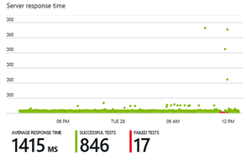
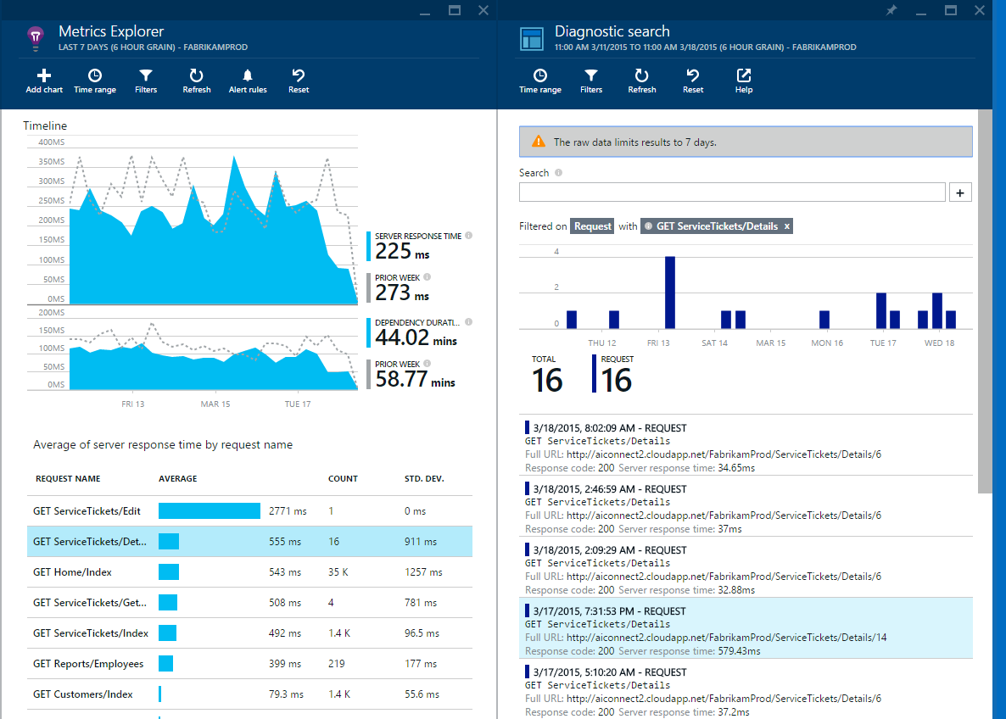
Fast and powerful insights
Identify & triage availability issues
Diagnose & solve performance problems
Mobile crash/sever exception analytics
Notes:
Monitor your web sites with simple pings to complex web tests from points around the world
Quickly diagnose issues by accessing rich application performance data from the client view to dependencies
Real time view of crashes happening on devices, allowing you to focus on fixing key issues with the biggest impact first

Slide 14
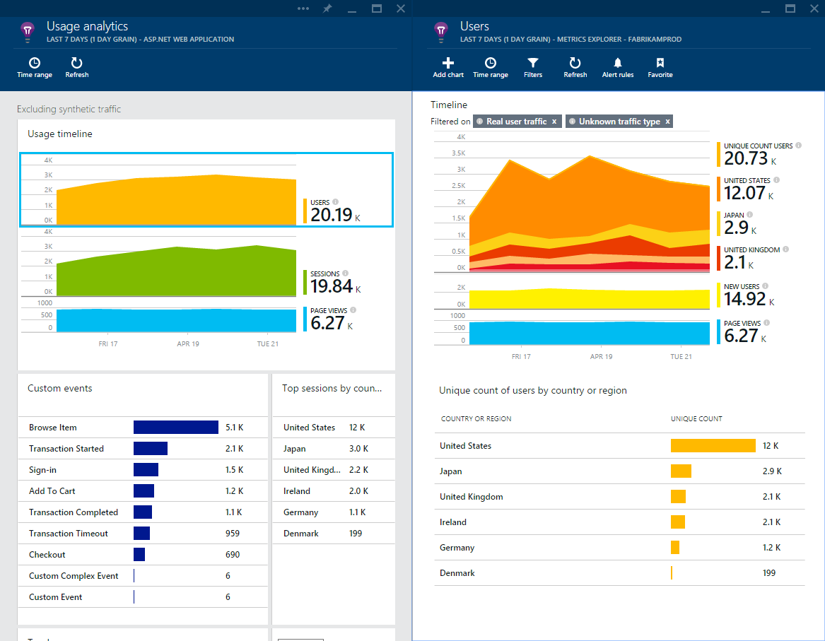
Fast and powerful insights
Learn & improve with usage insights
Notes:
Understand where your users are coming from and where they spend most of their time
Prioritize future investments and continuously improve your app based on user activity and usage patterns and trends

Slide 15
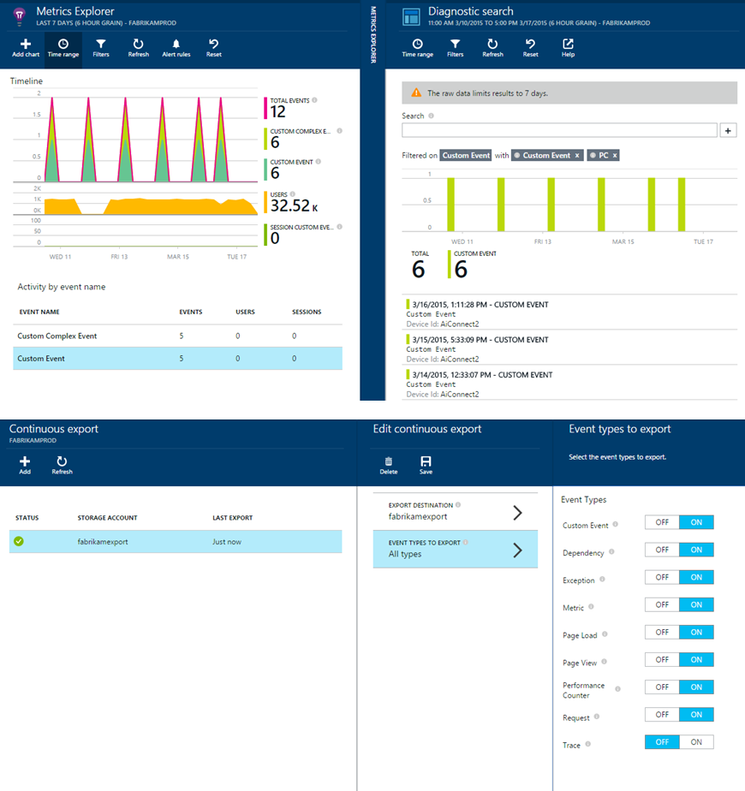
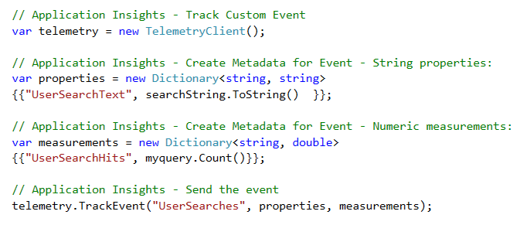
Fast and powerful insights
Extend telemetry data
Add custom metrics and events to better track and analyze user activity
Continuously export data to Azure Blob Storage for custom integration with other data sources and further analysis
Notes:
if you are running a vm and want to log vm information you need to add those agents to log information.
custom events. you have to add telemetery client which you can use to track custom evnets
couple of things to do , its not rocket science its very easy to get started.
do i have to run application on azure? no
if you run your application on local you can still install the agent and push to appinsights.appinsights is a service
mobile application, your app does not have to run on azure,

Slide 16
What is Jupyter Notebook?
“An opensource web application to create and share documents that contain live code, equations, visualizations and explanatory text."
1
Language of choice
Edit and run notebooks via a web browser
2
Big data integration
The kernels and a dashboard

Slide 17

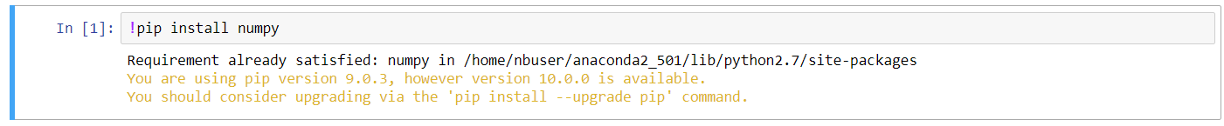
Here comes Azure Notebook
3
Great for sharing and collaborative work
1
Great memo pad - Write code like a sticky note
2
Execute in units of cells

Slide 18
Let’s code
Add Azure Application Insights to your ASP.NET Core web application
Dive into Azure Notebook with data analysis
AppInsights with Azure Notebook saves the day

Slide 19
Who wants some stickers?
Q & A

Slide 20
Where to go from here….
Access the demo and slides
https://github.com/sajeetharan/AzureBootCampAppInsights
Rate my session
https://www.rateevent.com/speeches/SCAAA663
Tweet me @kokkisajee
Notes:
Conclusion
structured logging enrich technical logs with business data
thank you for being here enjoy the rest of the day.

